Slide 1

This course was developed as a part of the VLIR-UOS Cross-Cutting projects:
Statistics: 2011-2016, 2017.
Statistics: 2017.
Statistics for development : 2018-2020.

Slide 2




Basic concepts in statistical inference using R:
Single comparison (Part 1)
The >eR-Biostat initiative
Making R based education materials in statistics accessible for all
Developed by Ziv Shkedy (Hasselt University, Belgium, July 2017)
based on an online course developed by
Marc Lavielle
Inria Saclay (Xpop) & Ecole Polytechnique (CMAP)
March, 2017
ER-BioStat
https://github.com/eR-Biostat
Email: erbiostat@gmail.com
@erbiostat

Slide 3
Contents
Introduction
Student’s t-test
  One sample t-test
  One sided test
  Two sided test
  Confidence interval for the mean
  Two samples t-test
  What should we test?
  Assuming equal variances
  Assuming different variances
  Power of a t-test
Mann-Whitney-Wilcoxon test
The limited role of the p-value
Equivalence tests
  Introduction
  Two samples test
  The TOST procedure
  Difference testing versus equivalence testing
  One sample test
Both slides and online materials are available.
These topics are not covered in the slides but online materials and R code are available.
http://sia.webpopix.org/statisticalTests1.html#the-limited-role-of-the-p-value
http://sia.webpopix.org/statisticalTests1.html#equivalence-tests

Slide 4
The course materials
Online materials can be found in
http://sia.webpopix.org/statisticalTests1.html

Slide 5

YouTube tutorials
YouTube tutorials related to the topics covered in the slides are available for:
  One sample t-test (host by Mike Marin): https://www.youtube.com/watch?v=kvmSAXhX9Hs
  Two samples t-test(host by Mike Marin): https://www.youtube.com/watch?v=RlhnNbPZC0A
  Wilcoxon test for two independent samples (host by Clarie Reed): https://www.youtube.com/watch?v=jkpRGUkzFn4
  Wilcoxon test for two independent samples using R (host by Mike Marin): https://www.youtube.com/watch?v=KroKhtCD9eE

Slide 6
Contents
Introduction
Student’s t-test
  One sample t-test
  One sided test
  Two sided test
  Confidence interval for the mean
  Two samples t-test
  What should we test?
  Assuming equal variances
  Assuming different variances
  Power of a t-test
Mann-Whitney-Wilcoxon test
The limited role of the p-value
Equivalence tests
  Introduction
  Two samples test
  The TOST procedure
  Difference testing versus equivalence testing
  One sample test

Slide 7
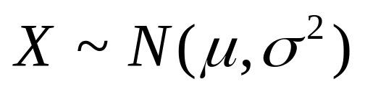
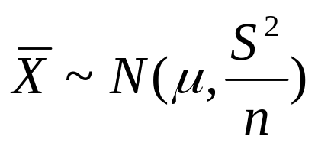
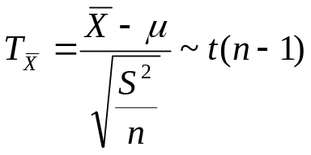
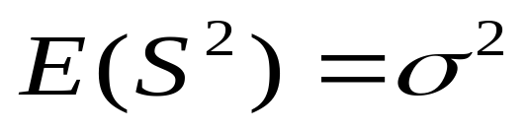
t-test for a population
We assume that X~N(μ,σ²)
For this test, we used the Student t distribution.
as
X has a normal distribution with unknown μ and σ².
than:
and

Slide 8
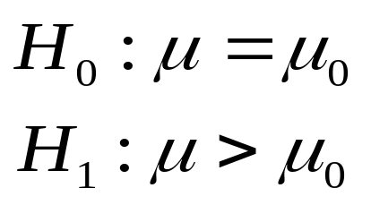
One sided t-test
One sided alternative:
We assume that

Slide 9
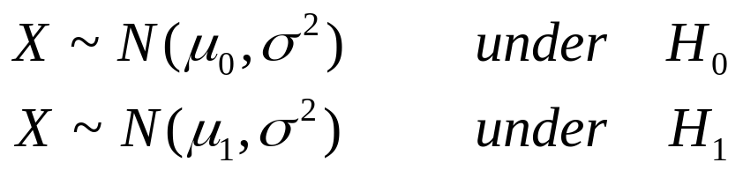
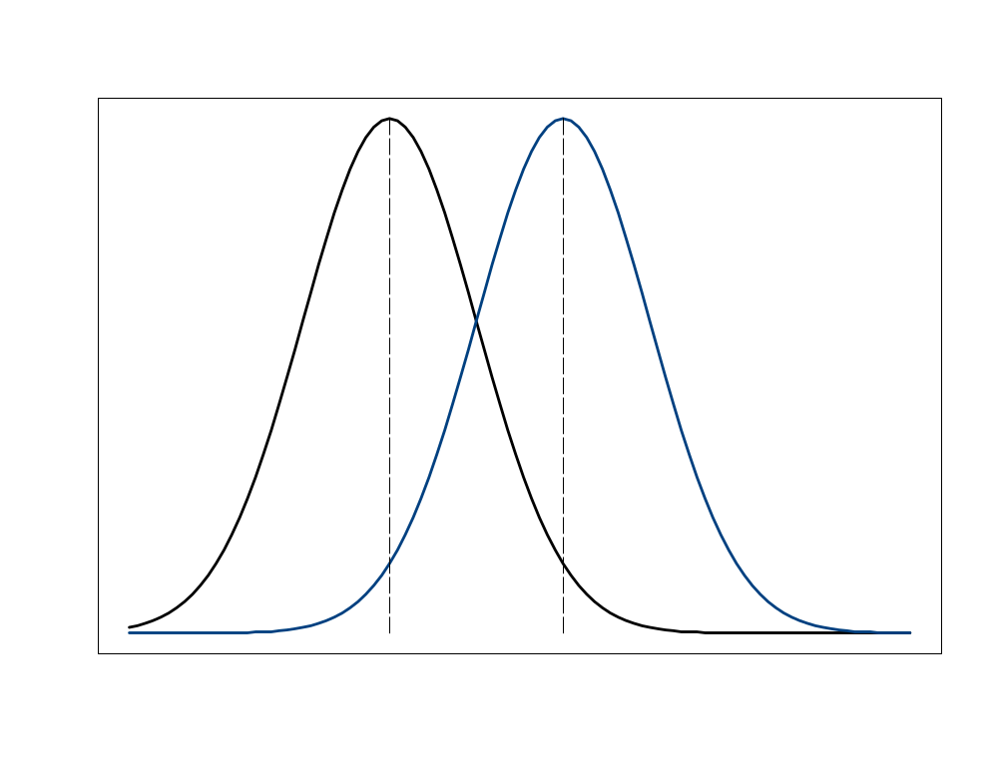
The distribution of the population
H₀
H₁
The distribution of population among H₁
The distribution of population among H₀
mu_0
mu_1

Slide 10
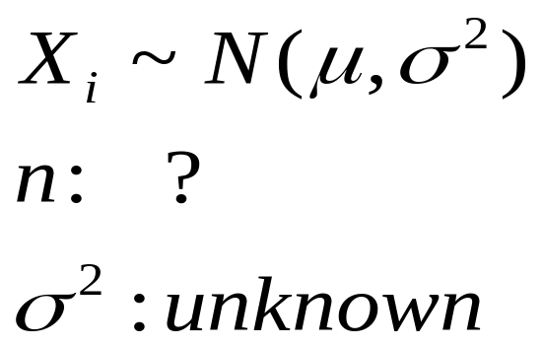
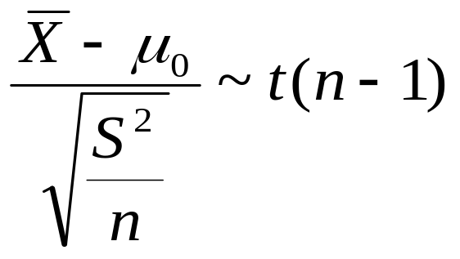
The sample & test statistic
To test the hypotheses, we draw a sample from the population.
X follows a normal distribution with unknown μ and σ².
The distribution of the test statistic population under H₀

Slide 11
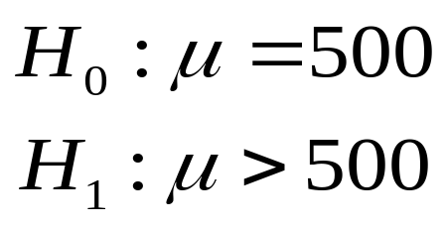
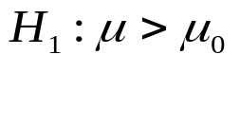

One sided t-test using R
The hypotheses:
R code:
> t.test(x, alternative="greater", mu=mu0)
data
The data (weight of male):
> x <- data[data$gender=="Male","weight"]
The mean under the null hypothesis
> mu0 <- 500

Slide 12
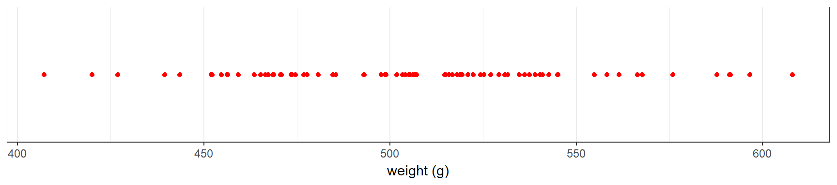
The data
Weight of 78 rat male.
> x <- data[data$gender=="Male","weight"]
> length(x)
[1] 78
> min(x)
[1] 407.2
> max(x)
[1] 608
> mean(x)
[1] 506.2218

Slide 13

R output for a one sided t-test
> t.test(x, alternative="greater", mu=mu0)
One Sample t-test
data: x
t = 1.2708, df = 77, p-value = 0.1038
alternative hypothesis: true mean is greater than 500
95 percent confidence interval:
498.0706 Inf
sample estimates:
mean of x
506.2218

Slide 14
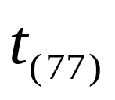
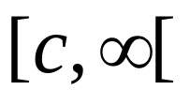
The rejection region
> t.test(x, alternative="greater", mu=mu0)
t = 1.2708, df = 77, p-value = 0.1038
Test statistic
> alpha <- 0.05
> n <- length(x)
> df <- n-1
> df
[1] 77
> qt(1-alpha, df)
[1] 1.664885
when the value of t is larger than
c then we reject the null
hypothesis
C=1.664885
rejection region

Slide 15

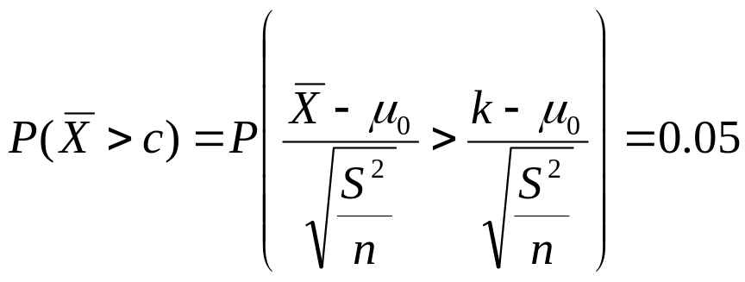
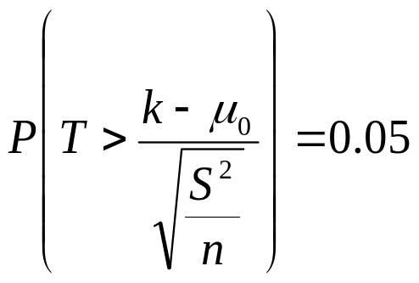
The choice of c
Determine c so that Type I error =5%
c

Slide 16
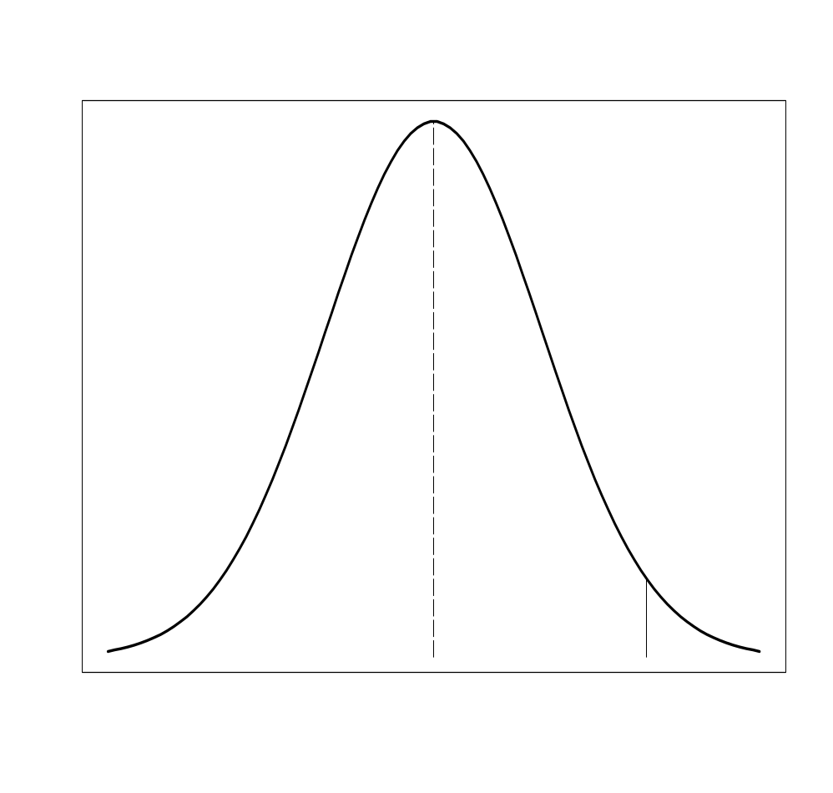
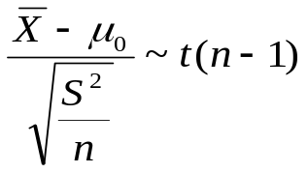

The critical point in R
The distribution of the test statistic under H₀
t(77)
> alpha <- 0.05
> n <- length(x)
> df <- n-1
> df
[1] 77
> qt(1-alpha, df)
[1] 1.664885
0.05
0
c

Slide 17
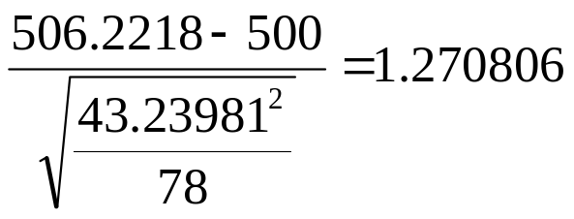
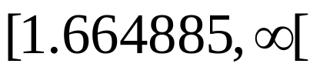

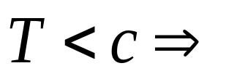
The rejection region & statistic in R
> x.mean <- mean(x)
> x.mean
[1] 506.2218
> x.sd <- sd(x)
> x.sd
[1] 43.23981
> n <- length(x)
> n
[1] 78
> t.stat <- sqrt(n)*(x.mean-mu0)/x.sd
> t.stat
[1] 1.270806
rejection region
1.664885
We do not reject H₀

Slide 18
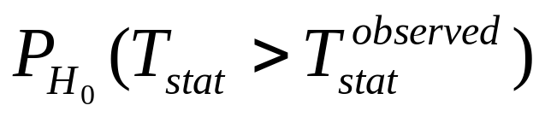
The p value in R
> t.test(x, alternative="greater", mu=mu0)
One Sample t-test
data: x
t = 1.2708, df = 77, p-value = 0.1038
alternative hypothesis: true mean is greater than 500
95 percent confidence interval:
498.0706 Inf
sample estimates:
mean of x
506.2218
> p.value <- 1 - pt(t.stat,df)
> p.value
[1] 0.1038119

Slide 19
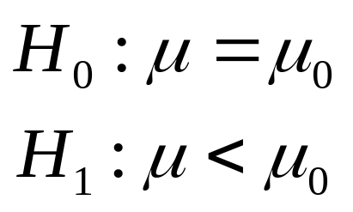
Example 2: one sided alternative
The hypotheses:
t-test in R:
> mu0 <- 515
> t.test(x, alternative="less", mu=mu0)

Slide 20

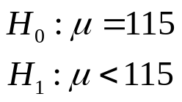
R output for a one-sided t-test
> t.test(x, alternative="less", mu=mu0)
One Sample t-test
data: x
t = -1.793, df = 77, p-value = 0.03845
alternative hypothesis: true mean is less than 515
95 percent confidence interval:
-Inf 514.373
sample estimates:
mean of x
506.2218

Slide 21
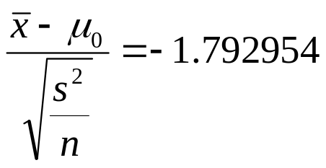
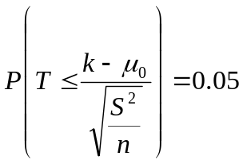

The test statistic in R
> x.mean <- mean(x)
> x.sd <- sd(x)
> n <- length(x)
> t.stat <- sqrt(n)*(x.mean-mu0)/x.sd
> t.stat
[1] -1.792954
> alpha <- 0.05
> n <- length(x)
> df <- n-1
> df
[1] 77
> qt(alpha, df)
[1] -1.664885
The critical point in R
-1.792954
-1.664885
rejection region

Slide 22

The p value in R
> t.stat
[1] -1.792954
> df
[1] 77
> p.value <- pt(t.stat,df)
> p.value
[1] 0.03845364
-1.792954

Slide 23
Contents
Introduction
Student’s t-test
  One sample t-test
  One sided test
  Two sided test
  Confidence interval for the mean
  Two samples t-test
  What should we test?
  Assuming equal variances
  Assuming different variances
  Power of a t-test
Mann-Whitney-Wilcoxon test
The limited role of the p-value
Equivalence tests
  Introduction
  Two samples test
  The TOST procedure
  Difference testing versus equivalence testing
  One sample test
YouTube tutorial:
https://www.youtube.com/watch?v=kvmSAXhX9Hs

Slide 24
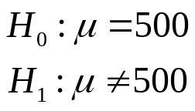
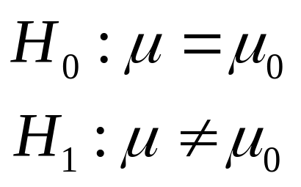
A two-sided test in R
The mean under H₀ is not equal to the mean under H₁ :
Twp sided test in R
> mu0 = 500
> t.test(x, alternative="two.sided", mu=mu0)

Slide 25

R output for a two sided t-test
> t.test(x, alternative="two.sided", mu=mu0)
One Sample t-test
data: x
t = 1.2708, df = 77, p-value = 0.2076
alternative hypothesis: true mean is not equal to 500
95 percent confidence interval:
496.4727 515.9709
sample estimates:
mean of x
506.2218

Slide 26
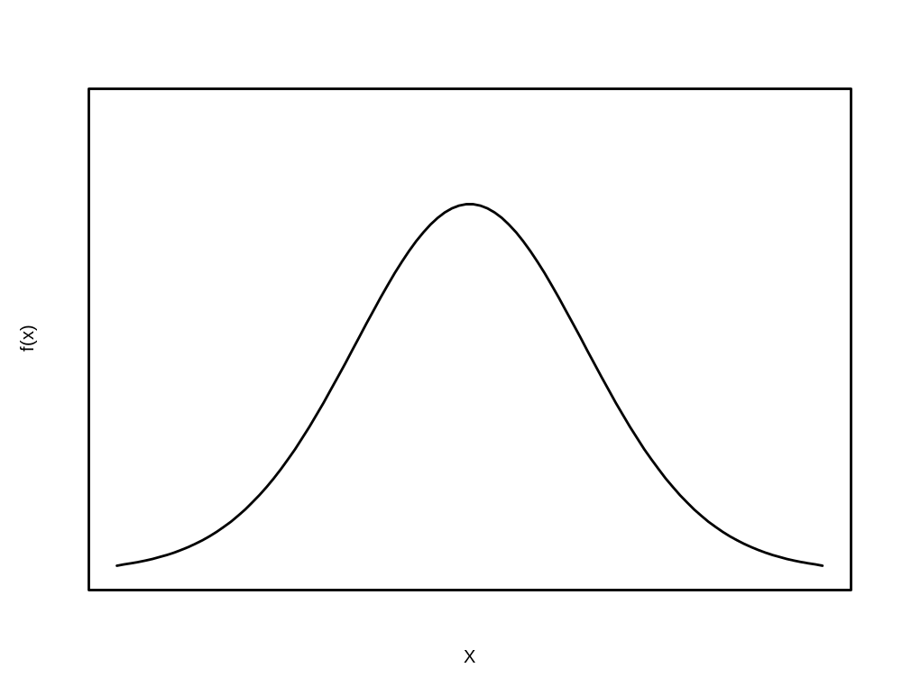
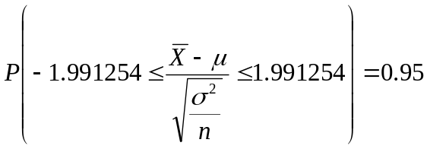
Critical values in R
t(n-1)
n=78 and α=0.05:
> alpha <- 0.05
> n <- length(x)
> df <- n-1
> df
[1] 77
> qt(1-alpha/2, df)
[1] 1.991254
P=0.025
95%
P=0.025
-c=-1.991254
c=1.991254

Slide 27
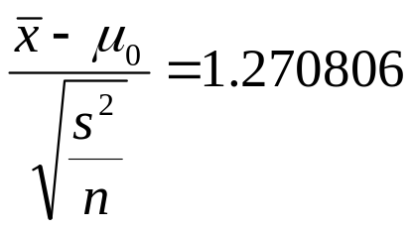
The rejection region
> x.mean <- mean(x)
> x.sd <- sd(x)
> n <- length(x)
> t.stat <- sqrt(n)*(x.mean-mu0)/x.sd
> t.stat
[1] 1.270806
> alpha <- 0.05
> n <- length(x)
> df <- n-1
> qt(1-alpha/2, df)
[1] 1.991254
rejection region
1.270806
rejection region
-1.991254
1.991254

Slide 28
The p value in R
> t.test(x, alternative="two.sided", mu=mu0)
One Sample t-test
data: x
t = 1.2708, df = 77, p-value = 0.2076
alternative hypothesis: true mean is not equal to 500
95 percent confidence interval:
496.4727 515.9709
sample estimates:
mean of x
506.2218
> p.value <- 2*pt(-t.stat,df)
> p.value
[1] 0.2076238

Slide 29
Contents
Introduction
Student’s t-test
  One sample t-test
  One sided test
  Two sided test
  Confidence interval for the mean
  Two samples t-test
  What should we test?
  Assuming equal variances
  Assuming different variances
  Power of a t-test
Mann-Whitney-Wilcoxon test
The limited role of the p-value
Equivalence tests
  Introduction
  Two samples test
  The TOST procedure
  Difference testing versus equivalence testing
  One sample test

Slide 30
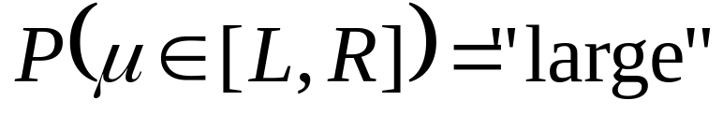
Confidence interval
On the basis of the sample, we look for an interval [L, R] so :
L
R
Left limit
Right limit
We find an interval [L, R] that contains the value of the population mean (μ) with "high probability"

Slide 31
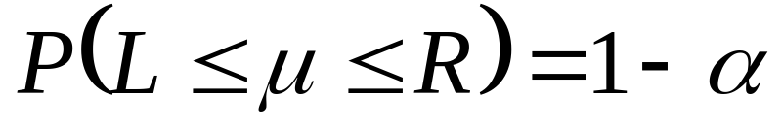

Confidence interval
Large → 1 - α
L
R
Left limit
Right limit
Example:

Slide 32
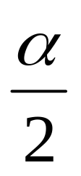

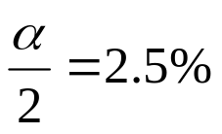
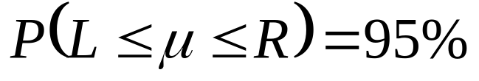
Confidence interval
We are looking for an interval so
L=left limit
R= right limit

Slide 33
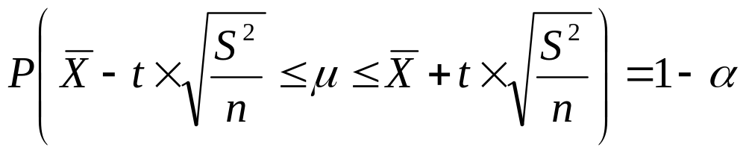
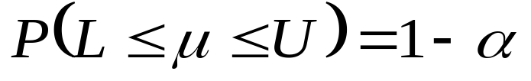
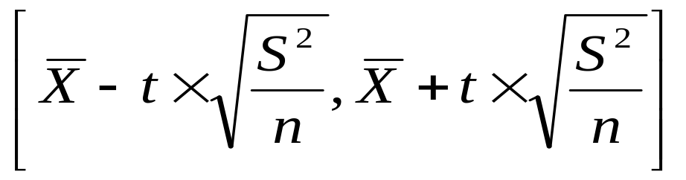
Confidence interval
L
R
A (1-α) CI for μ is :

Slide 34
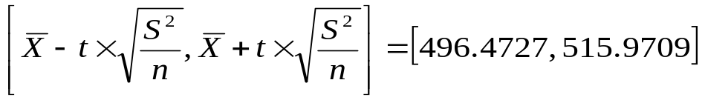
A 95% confidence interval in R
> t.test(x, alternative="two.sided", mu=mu0)
One Sample t-test
data: x
t = 1.2708, df = 77, p-value = 0.2076
alternative hypothesis: true mean is not equal to 500
95 percent confidence interval:
496.4727 515.9709
sample estimates:
mean of x
506.2218
> alpha <- 0.05
> n <- length(x)
> df <- n-1
> c.val<-qt(1-alpha/2, df)
> c.val
[1] 1.991254
> x.mean <- mean(x)
> x.mean
[1] 506.2218
> x.mean+c.val*(x.sd/sqrt(n))
[1] 515.9709
> c.val<-qt(1-alpha/2, df)
> c.val
[1] 1.991254

Slide 35
A 90% confidence interval in R
> t.test(x, alternative="two.sided", mu=mu0,conf.level = 0.90)
One Sample t-test
data: x
t = 1.2708, df = 77, p-value = 0.2076
alternative hypothesis: true mean is not equal to 500
90 percent confidence interval:
498.0706 514.3730
sample estimates:
mean of x
506.2218

Slide 36
Contents
Introduction
Student’s t-test
  One sample t-test
  One sided test
  Two sided test
  Confidence interval for the mean
  Two samples t-test
  What should we test?
  Assuming equal variances
  Assuming different variances
  Power of a t-test
Mann-Whitney-Wilcoxon test
The limited role of the p-value
Equivalence tests
  Introduction
  Two samples test
  The TOST procedure
  Difference testing versus equivalence testing
  One sample test
YouTube tutorial:
https://www.youtube.com/watch?v=RlhnNbPZC0A

Slide 37
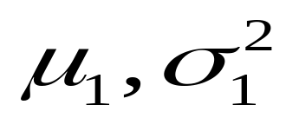
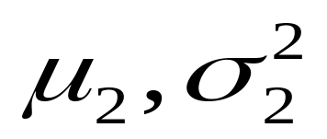
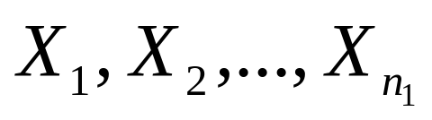
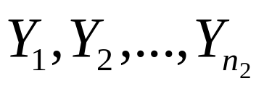
Two populations and two independent samples
Population 1
Population 2
We draw two samples independently
sample 1
Sample 2

Slide 38
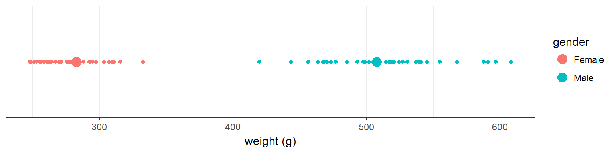
Example 1: weight of female vs. male - the data
> y <- data[data$gender=="Female" ,"weight"]
> length(y)
[1] 80
> mean(y)
[1] 282.8025
> x <- data[data$gender=="Male","weight"]
> length(x)
[1] 78
> mean(x)
[1] 506.2218
female
male

Slide 39
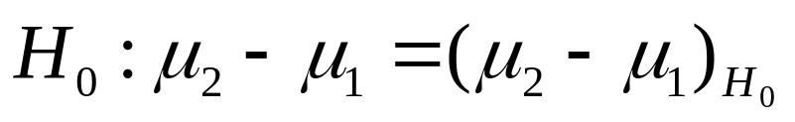
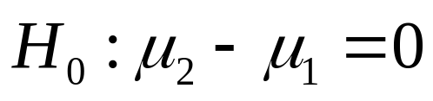
Two independent samples
We are interested in the difference between the two
means μ₁ and μ₂ and set the null hypothesis:
If the means of the two populations are equal then (μ₂-μ₁)_{H0}=0

Slide 40
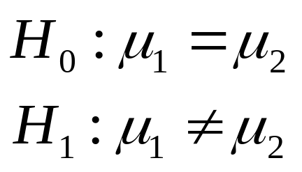
Two sided alternative
The hypotheses:
t-test in R:
> t.test(x, y)
The two samples:
y <- data[data$gender=="Female" ,"weight"]
x <- data[data$gender=="Male","weight"]
Two-sided t-test assuming unequal variance in the two populations (see later).

Slide 41
R output for a two samples t-test
> t.test(x, y)
Welch Two Sample t-test
data: x and y
t = 40.35, df = 117.08, p-value < 2.2e-16
alternative hypothesis: true difference in means is not equal to 0
95 percent confidence interval:
212.4535 234.3851
sample estimates:
mean of x mean of y
506.2218 282.8025
Two-sided test

Slide 42
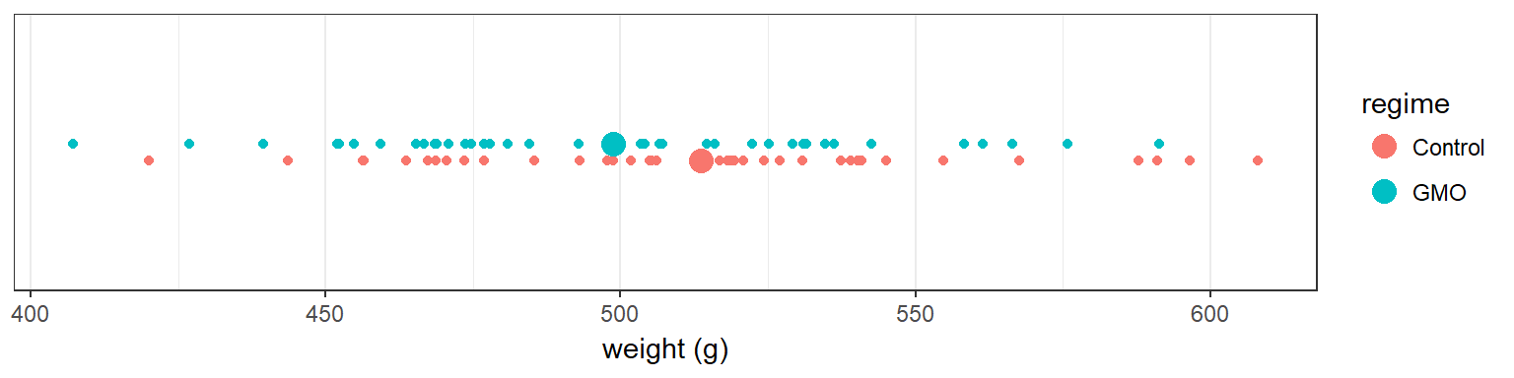
Example 2: weight control vs. GMO for male
> x <- data[data$gender=="Male" & data$regime=="Control","weight"]
> length(x)
[1] 39
> mean(x)
[1] 513.7077
> y <- data[data$gender=="Male" & data$regime=="GMO","weight"]
> length(y)
[1] 39
> mean(y)
[1] 498.7359
Treatment groups

Slide 43
Two sample t-test in R: equal variance
The hypotheses:
t-test in R:
> alpha <- 0.05
> t.test(x, y, conf.level=1-alpha, var.equal=TRUE)
σ₁² and σ₂²
unnown but σ₁² = σ₂²
95% C.I
Two-sided t-test assuming equal variance in the two populations

Slide 44
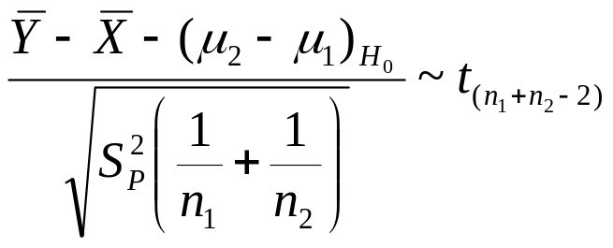
Assuming equal variances
1. both populations are normally distributed.
2. σ₁² and σ₂² unnown but σ₁² = σ₂²
pooled sample variance

Slide 45



R output for a two samples t-test (equal variance)
> t.test(x, y, conf.level=1-alpha, var.equal=TRUE)
Two Sample t-test
data: x and y
t = 1.5426, df = 76, p-value = 0.1271
alternative hypothesis: true difference in means is not equal to 0
95 percent confidence interval:
-4.358031 34.301621
sample estimates:
mean of x mean of y
513.7077 498.7359
> length(x)
[1] 39
> length(y)
[1] 39

Slide 46



Confidence interval
A (1-alpha)*100% confidence interval for the difference μ₂ - μ₁ is given by
> n1<-length(x)
> n2<-length(y)
> df<-n1+n2-2
> df
[1] 76
> alpha<-0.05
> qt(1-alpha/2,df)
[1] 1.991673

Slide 47




Assuming unequal variances
the populations are normally distributed.
σ₁² and σ₂² are unknown but

Slide 48
Two sample t-test in R: unequal variance
The hypotheses:
t-test in R:
> t.test(x, y, conf.level=1-alpha)
> t.test(x, y, conf.level=1-alpha, var.equal=FALSE)
σ₁² and σ₂²
unnown but
95% C.I

Slide 49
R output for a two samples t-test (unequal variance)
> t.test(x, y, conf.level=1-alpha, var.equal=FALSE)
Welch Two Sample t-test
data: x and y
t = 1.5426, df = 75.976, p-value = 0.1271
alternative hypothesis: true difference in means is not equal to 0
95 percent confidence interval:
-4.358129 34.301719
sample estimates:
mean of x mean of y
513.7077 498.7359

Slide 50
Contents
Introduction
Student’s t-test
  One sample t-test
  One sided test
  Two sided test
  Confidence interval for the mean
  Two samples t-test
  What should we test?
  Assuming equal variances
  Assuming different variances
  Power of a t-test
Mann-Whitney-Wilcoxon test
The limited role of the p-value
Equivalence tests
  Introduction
  Two samples test
  The TOST procedure
  Difference testing versus equivalence testing
  One sample test

Slide 51

Two sample t –test: one sided alternative
Δ: the true difference between the population means under the null hypothesis.

Slide 52
The two errors
population
 | H₀ is true | H₀ not true
reject H₀ | incorrect statement Type I error | correct statement
Not reject H₀ | correct statement | incorrect statement Type II error
Test results

Slide 53



Type I error and Power
Hypotheses:
For a given value of c, Type I error:
We reject H₀ when it is correct
Test statistic:
For a given value of c, power

Slide 54


Power calculation in R
Hypotheses:
To calculate the power we need to know:
One sided/two sided ?
Test statistic:
True difference in the populations
variance
Sample size

Slide 55


Power calculation in R
To calculate the power we need to know:
In R:
> alpha=0.05
> nx.new <- ny.new <- 80
> delta.mu <- 10
> x.sd <- 30
> df <- nx.new+ny.new-2
> dt <- delta.mu/x.sd/sqrt(1/nx.new+1/ny.new)
> dt
[1] 2.108185
One sided/two sided ?

Slide 56
Power calculation in R
Use the R package pwr.
Basic Functions for Power Analysis in R (CRAN).
  Power calculation for a given sample size.
  Sample size calculation for a given power.
YouTube tutorial (Calculatingg Power in R):
https://www.youtube.com/watch?v=7xghHcmQC50

Slide 57




Power calculation in R
In R:
> alpha=0.05
> nx.new <- ny.new <- 80
> delta.mu <- 10
> x.sd <- 30
> df <- nx.new+ny.new-2
> dt <- delta.mu/x.sd/sqrt(1/nx.new+1/ny.new)
> dt
[1] 2.108185
The pwr.t.test()function in R:
>pwr.t.test(n=nx.new,
d=delta.mu/x.sd,
type="two.sample",
alternative="two.sided",
sig.level=alpha)

Slide 58
Power calculation in R: output
> pwr.t.test(n=nx.new, d=delta.mu/x.sd, type="two.sample", alternative="two.sided", sig.level=alpha)
Two-sample t test power calculation
n = 80
d = 0.3333333
sig.level = 0.05
power = 0.5538758
alternative = two.sided
NOTE: n is number in *each* group

Slide 59
Power calculation in R: output
> pwr.t.test(n=nx.new, d=delta.mu/x.sd, type="two.sample", alternative="two.sided", sig.level=alpha)
Two-sample t test power calculation
n = 80
d = 0.3333333
sig.level = 0.05
power = 0.5538758
alternative = two.sided
NOTE: n is number in *each* group

Slide 60

Power calculation in R: output
> alpha=0.05
> nx.new <- ny.new <- 150
> delta.mu <- 10
> x.sd <- 30
> pwr.t.test(n=nx.new, d=delta.mu/x.sd, type="two.sample", alternative="two.sided", sig.level=alpha)
Two-sample t test power calculation
n = 150
d = 0.3333333
sig.level = 0.05
power = 0.820553
alternative = two.sided
NOTE: n is number in *each* group
Power for n=150 per group.

Slide 61

Sample size calculation for a given power and Type I error
> alpha=0.05
> delta.mu <- 10
> x.sd <- 30
> pwr.t.test(power=0.8, d=delta.mu/x.sd, sig.level=alpha)
Two-sample t test power calculation
n = 142.2462
d = 0.3333333
sig.level = 0.05
power = 0.8
alternative = two.sided
NOTE: n is number in *each* group
What is the sample size, per group for power of 80% and Type I error of 5% ?

Slide 62
Contents
Introduction
Student’s t-test
  One sample t-test
  One sided test
  Two sided test
  Confidence interval for the mean
  Two samples t-test
  What should we test?
  Assuming equal variances
  Assuming different variances
  Power of a t-test
Mann-Whitney-Wilcoxon test
The limited role of the p-value
Equivalence tests
  Introduction
  Two samples test
  The TOST procedure
  Difference testing versus equivalence testing
  One sample test

Slide 63
Wilcoxon test for two independent samples
This part of the course does not has slides. Instead, we suggest YouTube tutorials.
General explanation about Wilcoxon test for two independent samples:
https://www.youtube.com/watch?v=jkpRGUkzFn4
Wilcoxon test for two independent samples in R:
https://www.youtube.com/watch?v=KroKhtCD9eE

Slide 64
Two-samples Wilcoxon text in R
A general call of the R function wilcox.test() has the form of
wilcox.test(sample 1, sample 2,
alternative="two.sided",
conf.level=1-alpha)
For different alternatives use:
alternative = c("two.sided", "less", "greater")

Slide 65
R output for a two-sided Wilcoxon test for independent samples
> wilcox.test(x, y, alternative="two.sided", conf.level=1-alpha)
Wilcoxon rank sum test with continuity correction
data: x and y
W = 904.5, p-value = 0.1516
alternative hypothesis: true location shift is not equal to 0
Warning message:
In wilcox.test.default(x, y, alternative = "two.sided", conf.level = 1 - :cannot compute exact p-value with ties

